Slide 1

Decision making
Unit 3

Slide 2
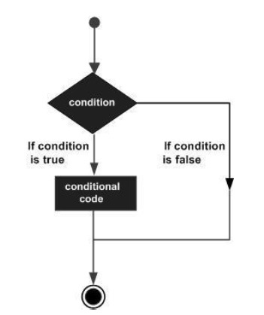
Why need conditional construct
Program need act differently based one some condition. So we need conditional/decision-making in programming

Slide 3
If statement
if (boolean_expression) {
// statement(s) will execute if the Boolean expression is true
}
Execute the statements inside if block, only when the condition evaluates to true.
If the condition is false those statements are all skipped.

Slide 4
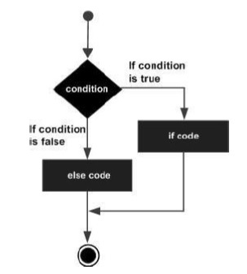
If else statement
if (boolean_expression) {
// statement(s) will execute if the Boolean expression is true
} else {
// statement(s) will execute if the Boolean expression is false
}
If the condition evaluates to true, the first if block statements will be executed.
If the condition evaluates to false, the second else block statement will be executed.
1 from 2 selection.

Slide 5
Else if ladder
if (boolean_expression1) {
// statement(s) will execute if the Boolean expression 1 is true
} else if (boolean_expression2) {
// statement(s) will execute if the Boolean expression 2 is true
} else {
// statement(s) will execute if the Both expression evaluate false
}
Will evaluate expression 1 first. If true select the first if block.
Only when expression 1 is false, will evaluate expression 2.

Slide 6
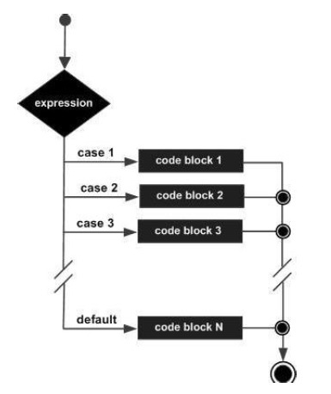
Case statement
select (variable_expression) {
case (constant_expression1): {
// statement(s);
break;
}
case (constant_expression2): {
// statement(s);
break;
}
default: {
// statement(s);
break;
}
}
Variable expression is evaluated and tested again each constant.
Constant expression must result in unique.
If no match will result in default.

